Slide 1
GREY WATER MANAGEMENT (GWM)
PIP2001 Capstone Project
Review- 4
Batch Number: G63
Under the Supervision of,
Dr . Prasad P S
Associate Professor
School of Computer Science and Engineering
Presidency University
Roll Number | Student Name
20211CSE0441 | SAHANA R
20211CSE0446 | RADHIKA RELEKAR
20211CSE0696 | SRUSTHI SINGH D T
20211CSE0467 | S FEROZ AHAMED
Name of the Program: B.tech
Name of the HoD: Mohammad Asif T
Name of the Program Project Coordinator: Dr . Sampath A K
Name of the School Project Coordinators: Dr. Sampath A K / Dr. Abdul Khadar A / Mr. Md Ziaur Rahman

Slide 2
Content
Introduction
Literature Review
Existing Methods-Drawbacks
Proposed Method
Architecture Diagram
Hardware and Software Details
Objectives
Time Line by Gantt Chart
References

Slide 3
Introduction :
Grey water refers to wastewater from household activities (e.g., sinks, showers, laundry)
that can be treated and reused.
Addressing water contamination and ensuring the sustainability of water resources are
critical.
Without adequate management, its discharge into rivers and lakes leads to water pollution, disrupting aquatic ecosystems and posing health risks
Implementing low-cost treatment solutions can help mitigate these issues, making grey water reusable for non-potable applications such as irrigation, toilet flushing, and groundwater recharge.

Slide 4
Literature Review
Research Paper Name | Pros | Cons | Drawbacks
Smith et al. (2017) | Low-cost, minimal maintenance, simple design | Effective for particulate matter | Ineffective against dissolved contaminants like heavy metals and chemicals.
Williams et al. (2018) | Environmentally friendly, cost-effective, sustainable | Slow start-up time, requires proper management | Limited by fluctuating environmental conditions, may be slow in high-load systems.
Kumar et al. (2019) | High efficiency in removing fine particulates and bacteria | Expensive, requires frequent maintenance | High operational cost, membrane fouling, waste by-products like brine are hard to manage.
Lee et al. (2020) | Integrated with rainwater harvesting, dual benefits for water conservation | Inefficiency due to high population densities, large volumes of grey water | Space constraints and large scale issues in urban areas, leading to inefficiencies.
Choi et al. (2021) | Easy to implement, cost-effective | Can remove oils, fats, and some chemicals | Residual chemicals may be harmful to the environment, causing toxicity and pollution.

Slide 5
Existing Methods-Drawbacks
Research Gap | Research Paper Name | Drawbacks
Inefficiency of Filtration Systems for Dissolved Contaminants | Smith et al. (2017) | Ineffective against dissolved contaminants like heavy metals and chemicals.
Challenges in Biological Treatment Systems | Williams et al. (2018) | Limited by fluctuating environmental conditions, may be slow in high-load systems.
High Operational Costs and Maintenance in Membrane Filtration | Kumar et al. (2019) | High operational cost, membrane fouling, waste by-products like brine are hard to manage.
Limitations in Urban Grey Water Management Systems | Lee et al. (2020) | Space constraints and large scale issues in urban areas, leading to inefficiencies.
Environmental Impact of Chemical Treatments | Choi et al. (2021) | Residual chemicals may be harmful to the environment, causing toxicity and pollution.

Slide 6
Proposed Methodology
Research Paper | Drawbacks | Proposed Methodology
Smith et al., 2017: Filtration systems using activated charcoal and sand | Fails to remove dissolved chemicals like heavy metals; limited effectiveness for fine particulates. | Hybrid Treatment System: Combination of filtration (sand/charcoal), biological (biofilters/constructed wetlands), and chemical treatments to target both large particulates and dissolved chemicals.
Kumar et al., 2019: Membrane filtration systems | Expensive; high maintenance due to membrane fouling. | Membrane Bioreactor (MBR) Systems: Combining membrane filtration with biological treatment for more effective contaminant removal and reduced fouling.
Choi et al., 2021: Low-cost chemical treatments (flocculants, coagulants) | Environmental concerns regarding residual chemicals; limited to certain pollutants like oils and fats. | Zeolite and Clay Adsorption Systems: Using natural materials for low-cost, eco-friendly removal of heavy metals and organic pollutants without chemical residues.
Sharma et al., 2019: Solar-powered UV disinfection | Reduced effectiveness in turbid or highly contaminated water. | Solar-Powered UV Disinfection: Enhanced UV disinfection with solar energy to ensure an eco-friendly, energy-efficient treatment method, suitable for off-grid areas.
Williams et al., 2018: Biological treatments (biofilters and constructed wetlands) | Slow implementation; requires proper maintenance and management. | Hybrid Treatment System: Integration with other methods, such as filtration, to improve efficiency and speed of treatment.

Slide 7
Hardware and Software Details
Software and Hardware Requirements:
Hardware Requirements :
Microcontroller
Water Flow Sensor
Pressure Sensor
Temperature Sensor
Relay Module
Water Pump
Jumper Wires
Breadboard
Software Requirements :
Programming Language: C/C++ (Arduino), Python
Development IDE: Arduino IDE
Data Handling : pandas, numpy (Python)
Machine Learning: scikit-learn
Visualization: matplotlib, seaborn
Data Storage: Google Drive, Google Sheets

Slide 8
Objectives
To Improve Water Quality through Efficient Contaminant Removal
To Minimize the Environmental Impact of Grey Water Disposal
To Improve the Efficiency and Scalability of Grey Water Treatment Systems
To Promote the Use of Renewable Energy in Water Treatment

Slide 9
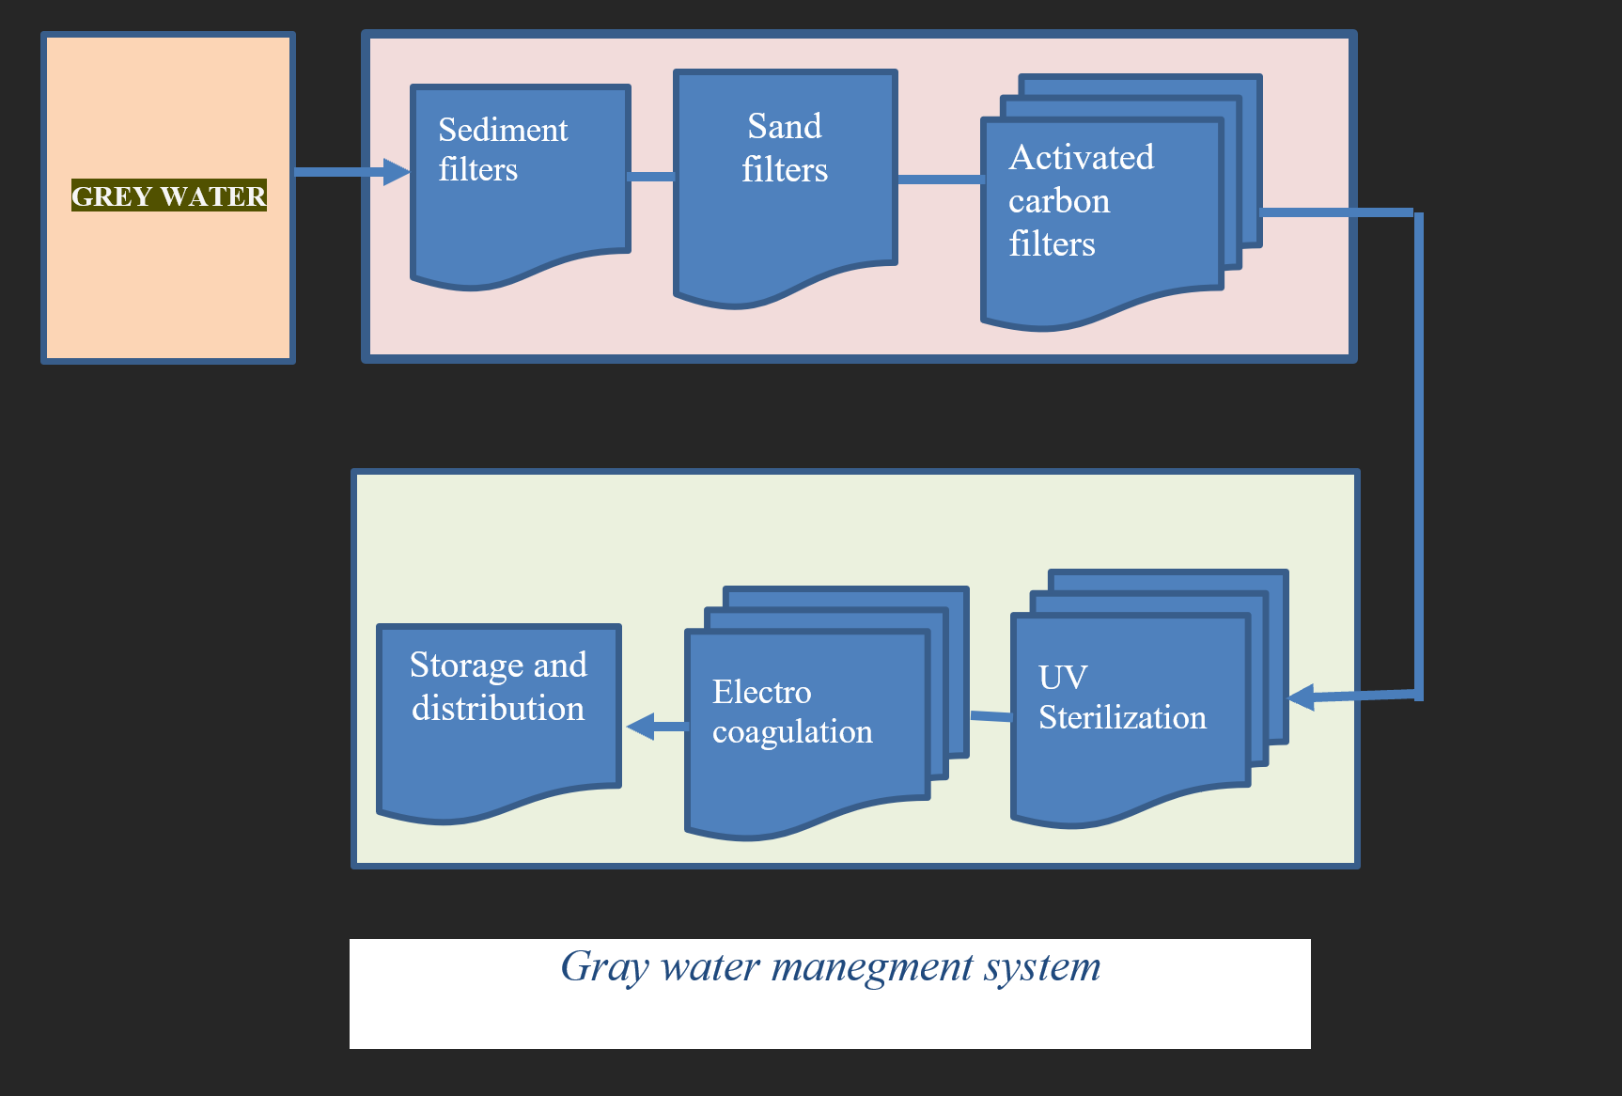
Architecture Diagram

Slide 10
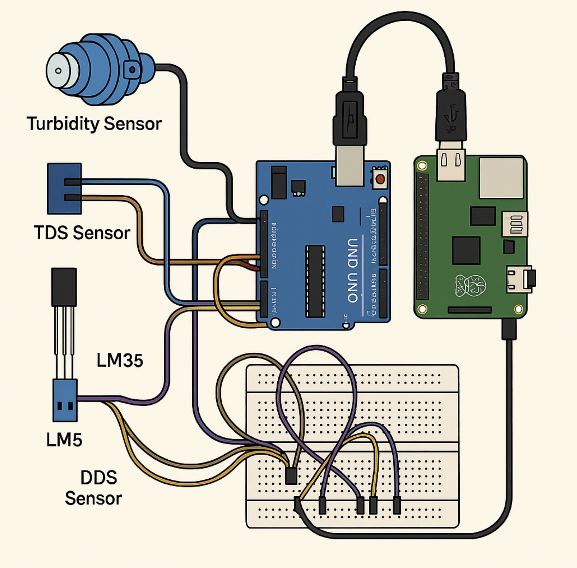
Circuit Diagram

Slide 11
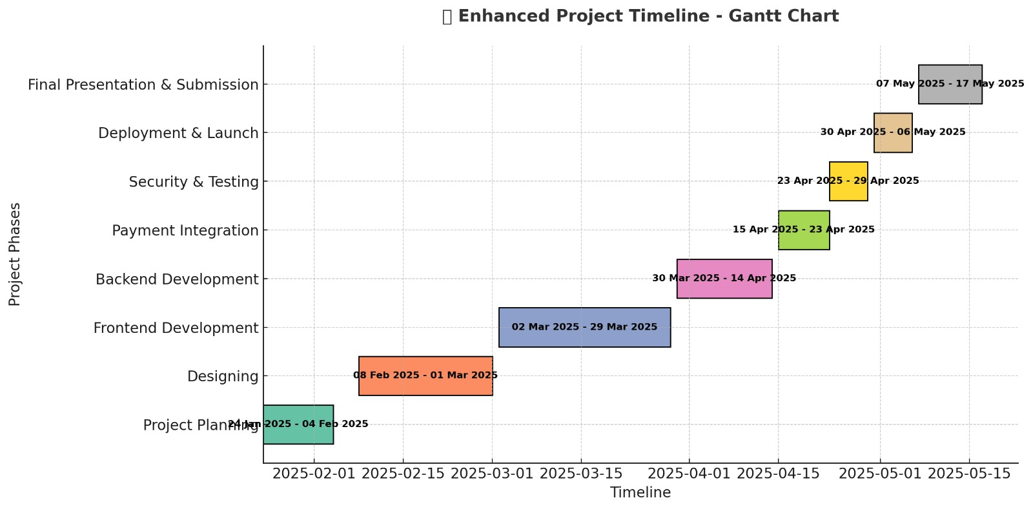
Timeline of the Project (Gantt Chart)

Slide 12
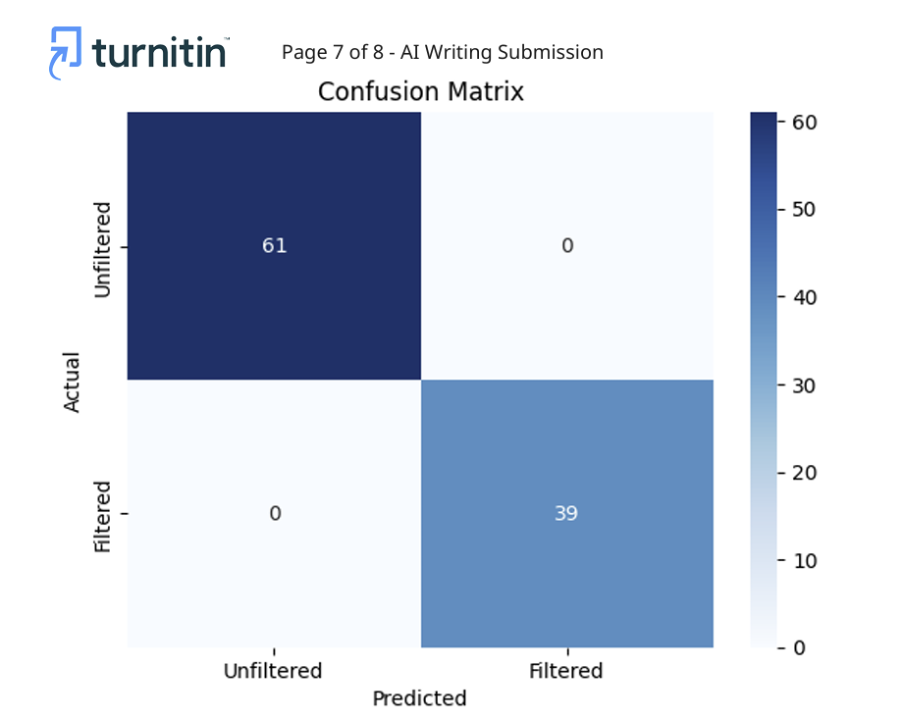
Output

Slide 13
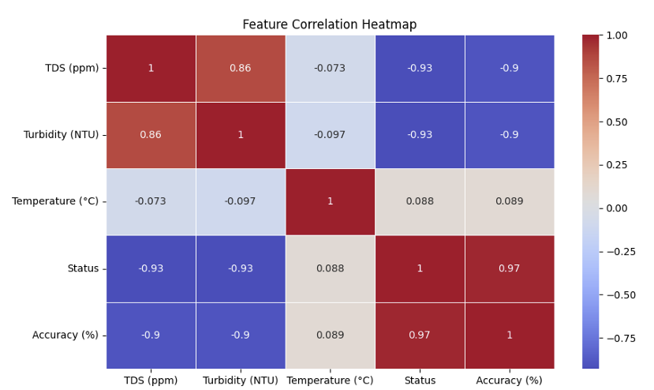
Output

Slide 14
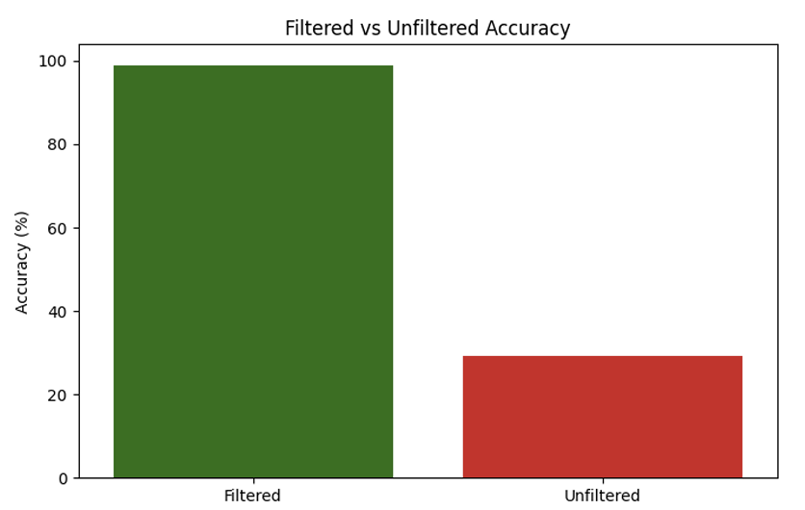
Output

Slide 15
References (IEEE Paper format)
1. A. D. Mande, B. R. Kavathekar, A. S. Langade, N. G. Lasankute, S. H. Patle,(2018), “Low Cost Household Water Treatment Systems: A Review”, International Journal of Engineering Research & Technology (IJERT), ISSN: 2278- 0181,Vol. 7 Issue 03.
2. Indranil Guin, Susheel Kumar Gupta,(2017) “Low Cost Methods of treatment of water for domestic purposes in Rural Areas”, International Journal for Scientific Research & Development, ISSN:2321-0613, Vol. 4, Issue 12.
3. S.Gautam, S.Ahmed, A. Dhingra, Z. Fatima, (2017), “CostEffective Treatment Technology for Small Size Sewage Treatment Plants in India, Journal of Scientific & Industrial Research, vol.76, pp.249-254.
4. EIZein Z, Abdou. A, Abd EL Gawad. I. (2016), “Constructed wetlands as a sustainable waste water treatment method in communities” (2016)pp, ISSN:605-617 ELSEVIER.
5. Karnapa Ajit. (2016) “A Review on Grey Water Treatment and Reuse”, International Research Journal of Engineering and Technology (IRJET) vol:03 Issue:05, may2016.
6. Sameer S Shastri (2014) “Zero Waste Disposal System for Multi-Storied Building.

Slide 16
References (IEEE Paper format)
7. Nargessh Amabadi, Hasan Bakhtiari, Nafise Kochakian, Mahamood Farahani, (2015) “The investigation and designing of an onsite greywater treatment system at Hazrat-e-Masoumeh University”, Qom, (IRAN) ISSN: 1337- 1346.
8. Sandhya Pushkar Singh, Nusrat Ali, Sabih Ahmad, Dr. J.K. Singh, Manoj Kumar,(2015), “A Study on Grey Water Treatment Processes: A Review”, International Journal for Scientific Research & Development, ISSN (online): 2321- 0613,Vol. 3, Issue 08.
9. Prof. K.D. Bhuyar, Mr.Amit. R. Lohakare, Mr.Tejas Patil, Mr.Yogesh Ghode, Ms.Sofiya Sayyad, (2015), “Treatment of Water by Membrane BIO Reactor”, International Journal for Scientific Research & Development, ISSN: 2321-0613, Vol. 2, Issue 12.
10. Vijaya V Shegokar et.al.(2015),”Design and Treatability Studies of Low Cost Grey Water Treatment with Respect to Recycle and Reuse in Rural Areas”.(ISSN):2319-7706 Volume 4 number 8 (2015)pp.
11. G.C. Biswas & Mirajul Islam et al. / International Soil and Water Conservation Research 3 (2015)- Assessment of the irrigation feasibility of low-cost filtered municipal waste water for red amaranth (Amaranths tricolor L cv.Surma).
12. Amr M. Abdel-Kader,(2013) “Studying the efficiency of greywater treatment by using rotating biological contactors system”. (2013) pp, ISSN: 89-95.

Slide 17


